Slide 1
IBM University Engagement Project Submission
“Exploring the Power of Agentic AI with IBM Granite and LangFlow”

Slide 2

Project Title – Document Q&A RAG Agent for Recipe Generator
Domain of Project – Food Technology / Artificial Intelligence
Student Name | Recent Passport Photo | Email ID | Mobile number [WhatsApp]
Neha Shirsath |  | nehashirsath1010@gmail.com | 8799936379

Slide 3
Problem Statement -
Problem Statement: Document Q&A RAG Agent for Recipe Generator
The Challenge
Food enthusiasts and culinary professionals often rely on unstructured recipe documents such as cookbooks, PDFs, blogs, handwritten notes, and online articles. Searching across these scattered resources is time-consuming, and adapting recipes based on dietary restrictions, available ingredients, cooking time, or cultural preferences is difficult. Existing recipe search systems mainly perform keyword searches and cannot understand natural language questions or generate personalized cooking guidance.
The Objective
Build an AI-powered Document Q&A Retrieval-Augmented Generation (RAG) Agent that intelligently retrieves and personalizes recipes.
The solution should:
• Ingest and index recipe documents from PDFs, cookbooks, blogs, and uploaded notes.
• Enable conversational question answering for recipe-related queries.
• Personalize recipes based on dietary restrictions, available ingredients, cooking time, and cuisine preferences.
• Generate step-by-step cooking instructions.
• Suggest ingredient substitutions.
• Display nutritional facts and generate shopping lists.

Slide 4
Proposed Solution -
Proposed Solution: AI-Powered Recipe Generator using Document Q&A RAG
The proposed solution is an AI-powered Document Q&A RAG Agent built using IBM LangFlow, IBM watsonx.ai, IBM Granite Models, and Retrieval-Augmented Generation (RAG). The system transforms traditional recipe documents into an intelligent cooking assistant capable of answering natural language questions and generating personalized recipes.
The solution begins by ingesting recipe documents from cookbooks, PDFs, blogs, and handwritten notes. These documents are parsed, cleaned, divided into semantic chunks, and converted into vector embeddings. The embeddings are stored inside a Vector Database (FAISS or ChromaDB), enabling semantic search over thousands of recipes.
When users ask questions such as:
"How can I make a sugar-free chocolate cake?"or"Suggest a high-protein Indian dinner using paneer and spinach."
the Retriever searches the knowledge base and provides the most relevant recipe information to IBM Granite Models through the RAG pipeline.
The AI then generates personalized cooking instructions according to user preferences such as: Dietary restrictions, Available ingredients, Cooking time, Cuisine preferences,Skill level
The generated response includes:
• Personalized recipe
• Step-by-step cooking instructions
• Ingredient substitutions
• Nutritional facts
• Estimated cooking time
• Shopping list
IBM LangFlow orchestrates the complete multi-agent workflow, while IBM watsonx.ai manages embeddings, model deployment, and AI governance. Granite Models perform reasoning, summarization, recipe adaptation, and conversational interactions.
Overall, the solution delivers an intelligent, personalized, and context-aware cooking assistant that simplifies recipe discovery and enhances the cooking experience.

Slide 5
Technology Used
IBM LangFlow - Used for designing and orchestrating the multi-agent workflow visually.
IBM Granite Model - Granite-4.0-8B-Instruct
Used for:
• Natural language understanding
• Recipe generation
• Conversational reasoning
• Personalization
IBM Cloud -Provides scalable cloud infrastructure for deploying the Recipe Generator securely and efficiently.
Retrieval-Augmented Generation (RAG)
Retrieves authentic recipe information from uploaded documents before generating responses, ensuring accurate and context-aware recipe recommendations.
IBM watsonx.ai
Used for:
• Model deployment
• Embedding generation
• AI governance
Vector Database (FAISS / ChromaDB)
Stores recipe embeddings for semantic search and fast retrieval.

Slide 6
Langflow component Used -
1. Chat Input- Accepts user questions and preferences such as:
• Available ingredients
• Dietary restrictions
• Cuisine
• Cooking time
2. IBM watsonx AI Agent- Processes user queries using IBM Granite Models and retrieves relevant recipe knowledge through RAG.
3. IBM Granite Model - Granite-4.0-8B-Instruct
Generates:
• Personalized recipes
• Ingredient substitutions
• Cooking guidance
• Shopping lists
4. Chat Output - Displays: Recipe, Cooking steps, Nutrition,Shopping list,Tips
5. File Component - Uploads recipe documents including:
• PDFs
• Cookbooks
• Blogs
• Recipe notes
6. Vector Store Component
Stores document embeddings for semantic retrieval.
7. Embedding Component
Converts recipe chunks into vector embeddings before storage.

Slide 7
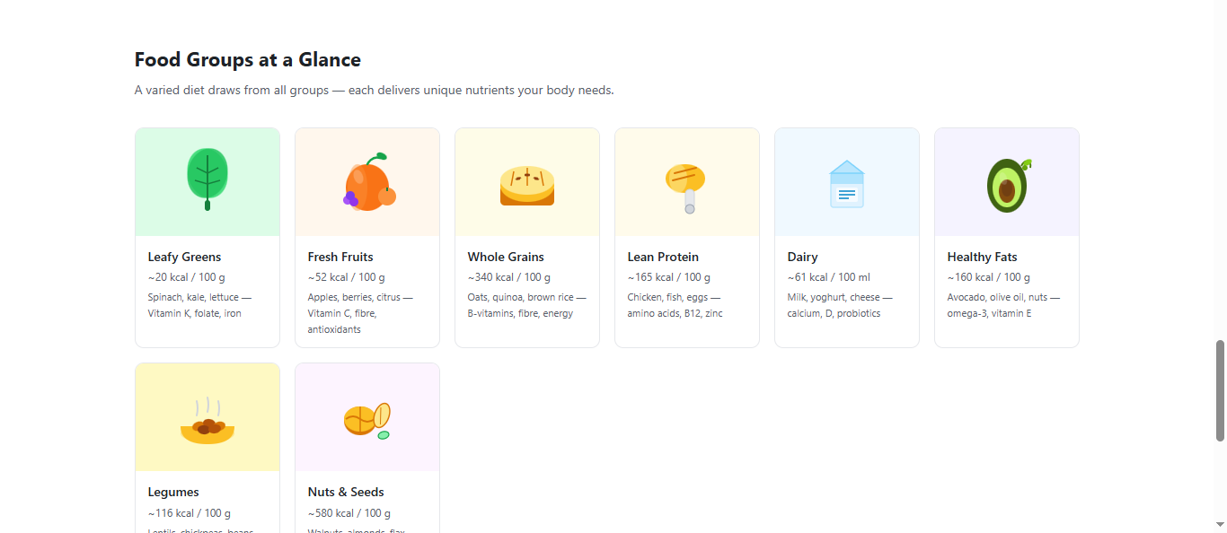
Langflow workflow -

Slide 8
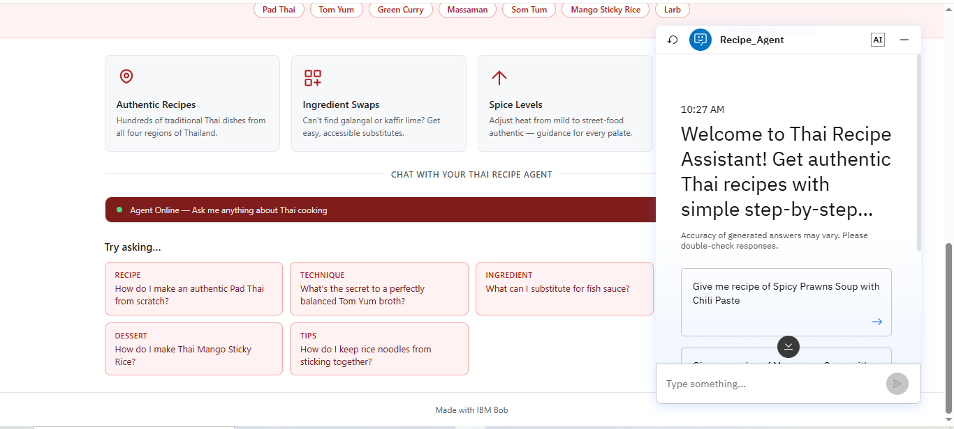
Architecture blueprint

Slide 9

Role of Agentic AI in the solution
Role of Agentic AI in Solution
Agentic AI enables the Recipe Agent to function as an intelligent, autonomous system rather than a simple chatbot. Using IBM watsonx.ai and IBM Granite models, it coordinates multiple specialized agents to deliver personalized nutrition guidance.
Each agent performs a specific role—such as retrieving nutritional data, generating diet plans, providing health advice, and analyzing food logs—while working collaboratively. This multi-agent approach ensures efficient task execution and accurate results.
Agentic AI also brings context awareness, understanding user details like age, health conditions, and fitness goals to generate tailored recommendations. It supports real-time adaptation, continuously updating suggestions based on user inputs like daily meals.
Additionally, agents communicate with each other, enabling better decision-making and improved outcomes.
Overall, Agentic AI makes the system proactive, personalized, and goal-driven, acting like a smart digital nutritionist that helps users maintain a healthy lifestyle.

Slide 10
Novelty and Uniqueness
The proposed Recipe Generator combines Agentic AI, Retrieval-Augmented Generation (RAG), and conversational intelligence into one unified cooking assistant.
Document-Based Intelligence – Retrieves information from uploaded recipe documents instead of relying only on pretrained knowledge.
RAG-Based Accuracy – Ensures trustworthy responses by grounding answers in actual recipe sources.
Personalized Cooking – Adapts recipes based on dietary needs, available ingredients, cuisine, cooking time, and user preferences.
Natural Language Conversations – Users interact with the system using simple conversational questions.
Smart Ingredient Substitution – Suggests suitable alternatives for unavailable ingredients.
Automatic Shopping Lists – Generates ingredient shopping lists instantly.
Nutrition Insights – Estimates calories and nutritional values.
Enterprise Ready – Built using IBM LangFlow, IBM watsonx.ai, IBM Granite Models, and RAG architecture.
This transforms traditional recipe search into a smart AI-powered cooking assistant.

Slide 11
Git Hub Link
Please create public github repository (Enable Add README button while creating repository) with format –
Please test and Paste the working Github URL –
Make sure you have Uploaded following three files into your github repository 1) app.json file , 2) yourproblemstatement.pdf file 3) your projectpresntation.pptx file 4)any other files
·
·
·

Slide 12
Future Scope
1. Voice-Based Cooking Assistant
Users can ask recipe questions through voice while cooking.
2. Image-Based Ingredient Recognition
Upload refrigerator images to identify available ingredients and generate recipes automatically.
3. Regional Language Support
Support recipes and conversations in multiple Indian and international languages.
4. Meal Planning
Generate personalized weekly and monthly meal plans.
5. Smart Kitchen Integration
Integrate with IoT-enabled kitchen appliances for automated cooking guidance.
6. Health-Aware Recommendations
Recommend recipes based on medical conditions such as diabetes, hypertension, obesity, and allergies.
·
·
·

Slide 13
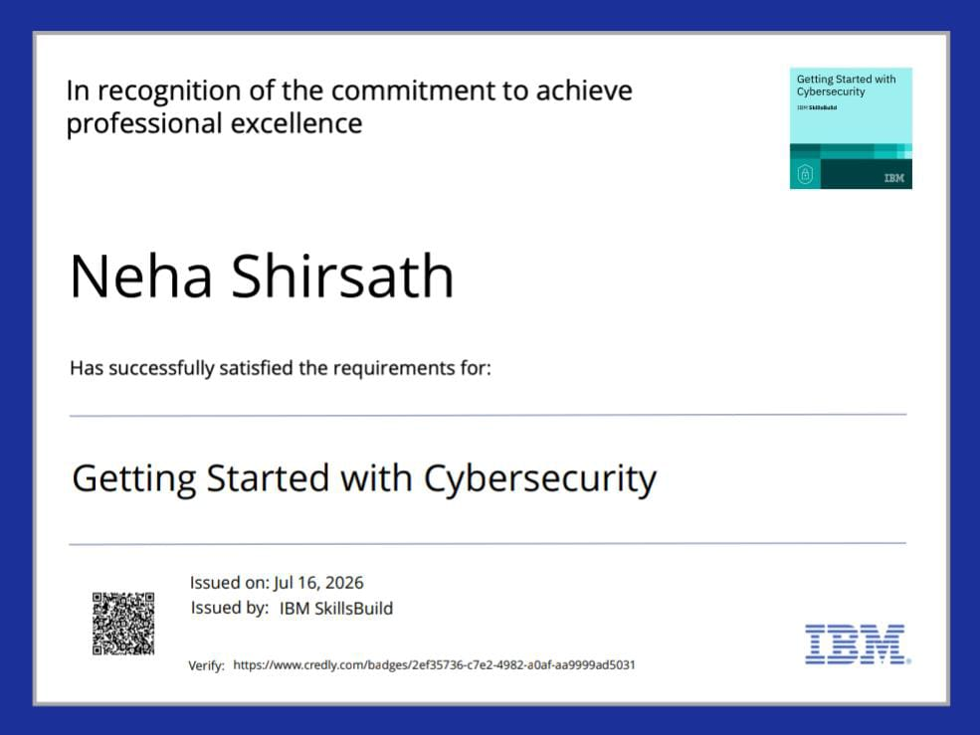
Certificates Earned:
Please add your credly certificate

Slide 14


Slide 15
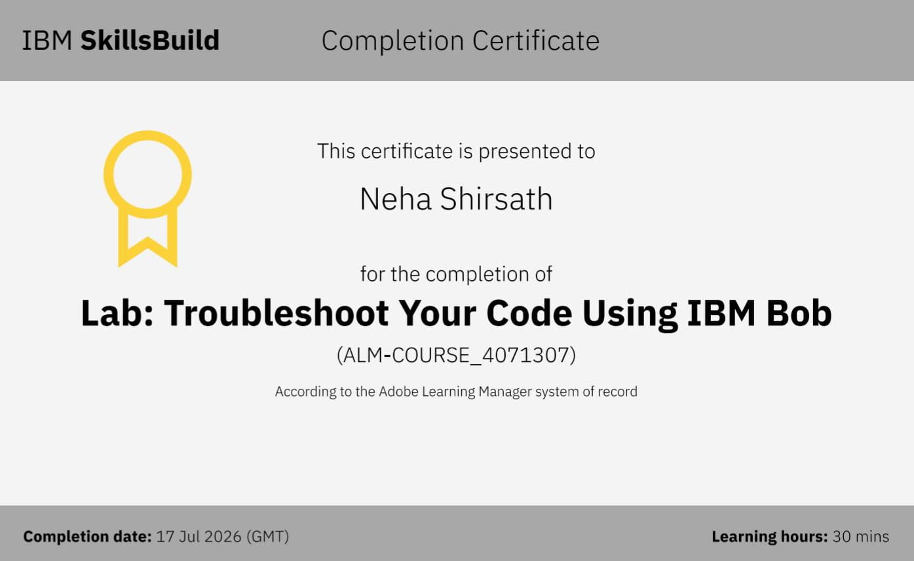
Certificates Earned:​
Add your IBM BOB Certificate

Slide 16


